Slide 1
Delegates and events
CT4027 – Tools Programming

Slide 2
Delegates
Delegates are references to functions
Or, to put it another way, a way of saving a function to a variable to call later, just like we can have a class variable
When we declare these, the declaration of the delegate has to specify exactly what arguments it takes (and returns)
So after using the keyword “delegate” then the rest looks a bit like declaring a function

Slide 3
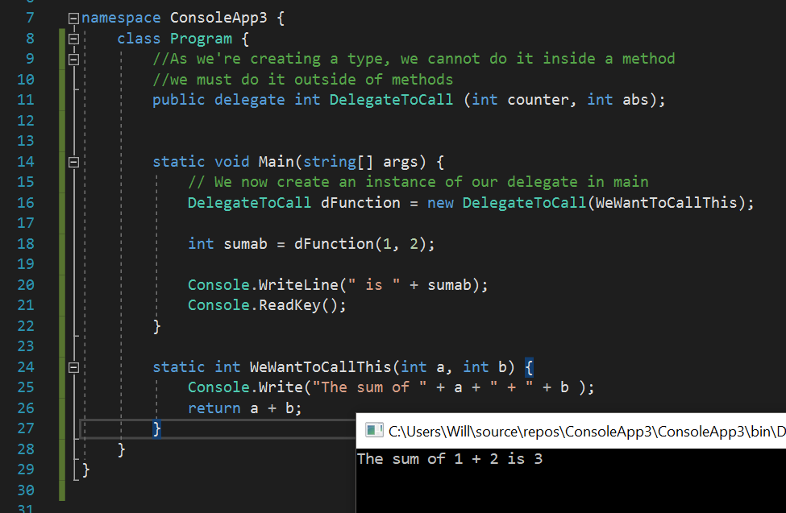
Delegates - Example

Slide 4
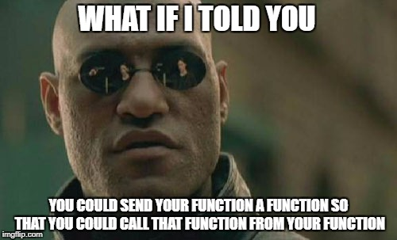
Delegates as function parameters
You can use delegates like any other variable
Which means you can supply them to a function as a parameter
That function can then use the delegate to call the original function that it has been passed

Slide 5
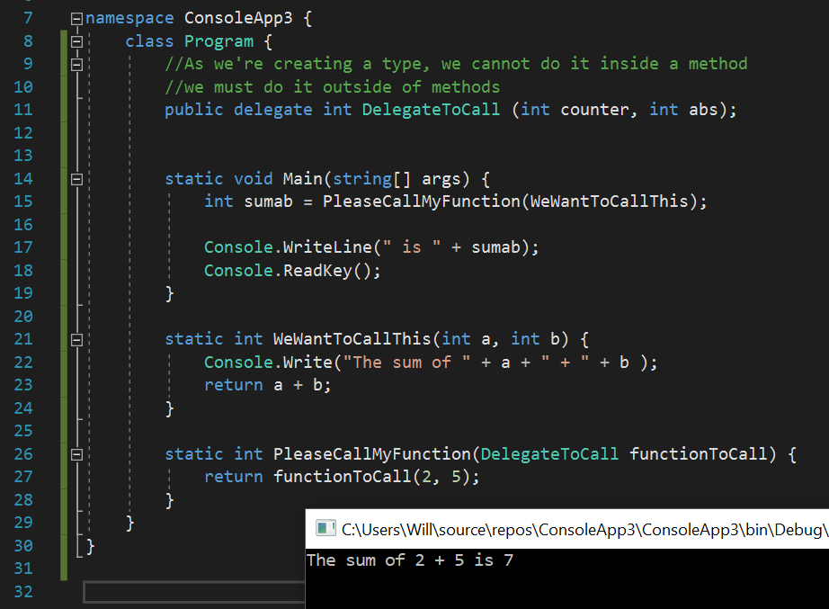
Delegates as function parameters - example

Slide 6
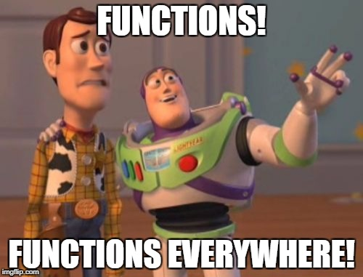
Multicast Delegate Functions
But wait – there’s more!
Our delegates can reference more than one function, provided their signatures match
This means that provided they return the same type, and have the same types of parameters
It’s best to stick to void return types with multicast delegates, as you will only receive the result from the last called function
When our delegate references multiple functions, each function it references is called in turn
We add extra functions to our delegate with the ‘+’, or ‘+=‘ operators
We can also remove functions from our delegate with the ‘-’ and ‘-=‘ operators

Slide 7
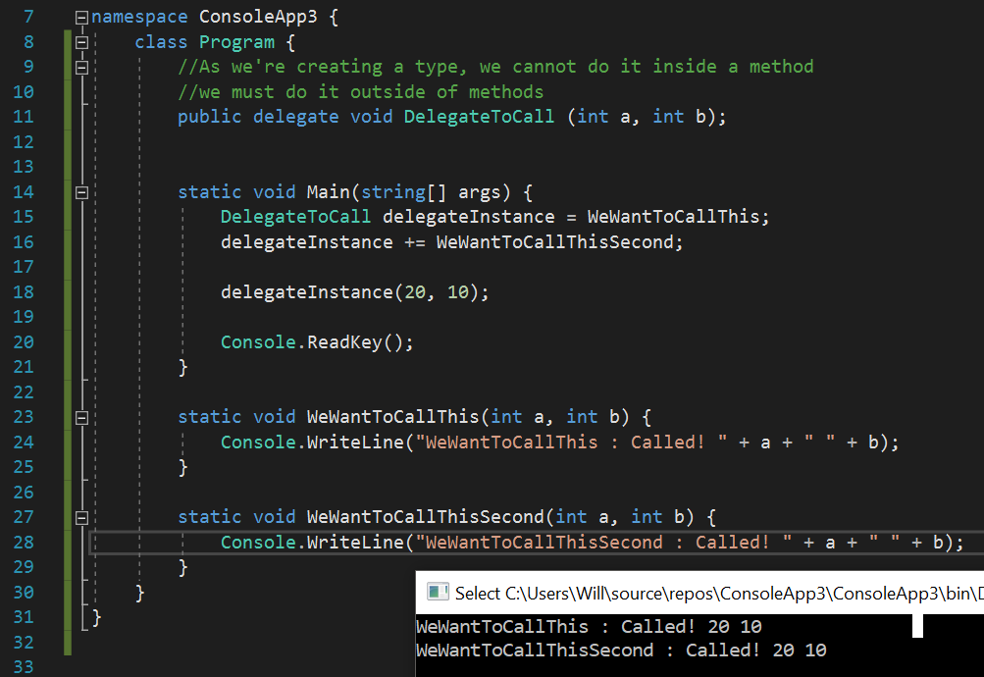
Multicast Delegate Functions - Example

Slide 8
Great (and confusing!) but when would we use this?
If want to notify lots of people of something.
Say you have a team game where you would add health to all members of the party with a delegate called 'void IncreaseTeamHealth(int healthAmount)'
When using an item in your inventory, you could invoke the delegate 'IncreaseTeamHealth' and all team players would add the amount to their HP (if alive).
Or say, you setup a delegate when a player has died. To notify people/enemies that wanted to subscribe.
With this system you can have a way of notifying other classes at useful events, even if you haven't programmed a class that cares for this event yet.

Slide 9
Task #1
Open visual studio
By referring to the slides, and the demonstrations on them, create a delegate type, which returns an int and takes two ints
Create two functions, one which adds two ints together and returns the result, one which multiplies them and returns the result
Write a main function which creates a variable of that delegate type, assigns the addition function to it, calls it and prints the result, then assigns the multiplication function to it, calls it and prints the result

Slide 10
So – what’s wrong with multicast delegates to broadcast events?
If we set the delegate to null or re-assign instead of add by accident we lose all the current subscribers (which is hard to find when debugging)
Subscriber has full control:
Anybody who has access to the delegate can invoke the delegate.
Any other subscriber has access to remove another subscriber without their knowledge

Slide 11
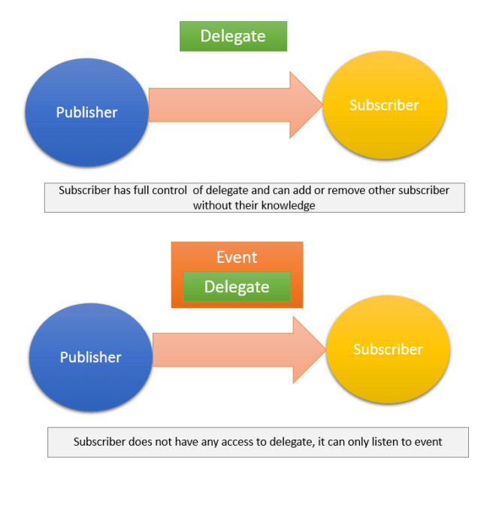
So, what can we do?
Enter events
Events are a wrapper around delegates – that only allow subscribers to the event to listen, or unsubscribe – not to modify the underlying delegate
Only the class who make the event can invoke it
When we want to create an event, there are two parts to this process
First, we create a delegate type as in previous examples
Then we create a public event in the class, using the delegate type, which other classes methods can then subscribe to
This is best shown with an example

Slide 12
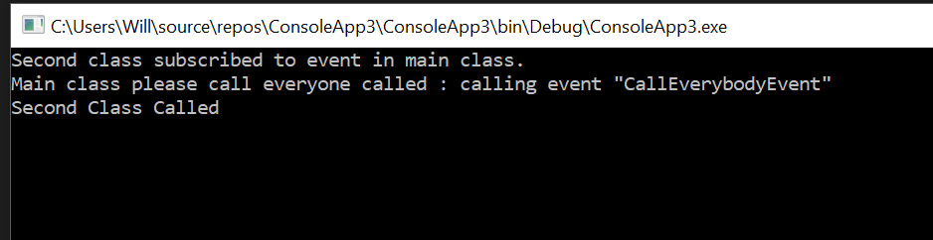
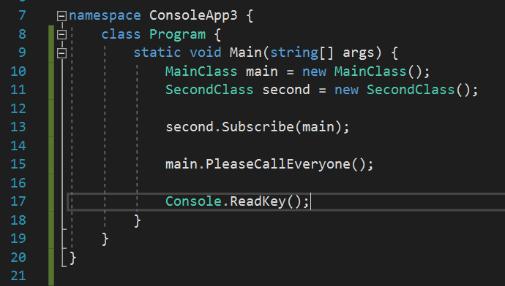
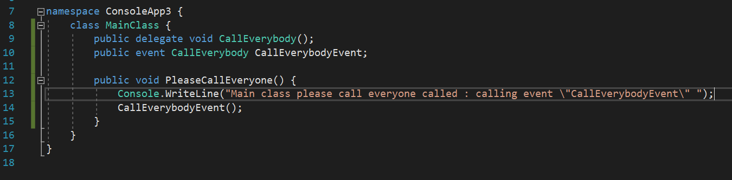
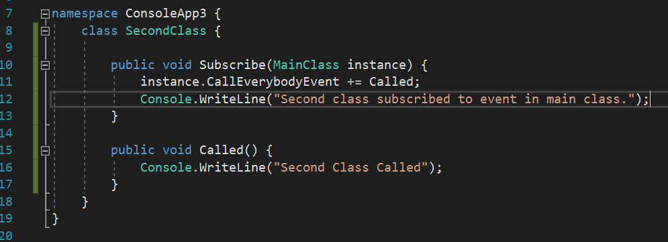
Events in C#, Example

Slide 13
Task #2
Enter the code given in the Events in C# example, creating two additional classes, and coding as appropriate.
Add an extra class “thirdclass”, and subscribe this class to the event in main class also
Set a break point in main, and run through the code step by step, observing the flow through the events and functions
Alter the code so that rather than an event, main class has a public instance of a delegate, which the two other classes add their functions to
Try setting the delegate to null in one of your classes, then calling the delegate again

Slide 14
So why are we learning all this?
Windows programming in C# uses events heavily
It is in fact, what is known as “Event driven programming” – all the code you write is usually executed in response to some event
To allow responses to button presses, changes in text fields, etc.
Unity also uses events heavily, and effectively coding in Unity is also event driven programming
We can use events in our own code, when we have things happening in our classes that we may want other classes to respond to

Slide 15
Default event signature
Most default events in C# windows programming have a certain signature by convention
This is void EventName (object sender, EventArgs e)
We can also create events with this signature, to fit with the convention
Sender is normally just given the “this” keyword when the event is being fired
“this” in C# is a keyword which returns a reference to the current object
EventArgs can either use the normal eventargs class, or we can create our own class that inherits from eventargs and pass this
We probably won’t need to do this, but knowing how it works will help you to understand how Windows programming works

Slide 16
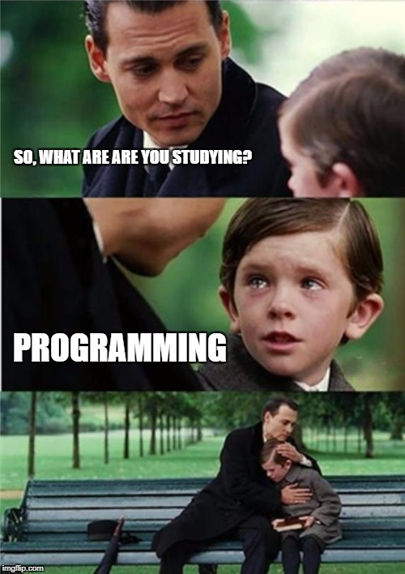
Any Questions?

